Slide 1
Guerre Geo
Requirements and Development
Group 4 : Janki , Aiwan , Ishta, and Henvy

Slide 2

Overview
Choose teams
Visit Coinspot or hotspot
Solve défi
Duel challenge
Notes:
Users can choose between team Warrior and team Bandits
Player have to go to Coinspot
Solve défi
Earn coins for team and personal account
Player have to go to hotspot
Solve défi
Earn gems
Duel challenge to player from opposite team
Winner gets coins
Loser loses coins

Slide 3
Product Use Cases
&
Functional Requirements

Slide 4
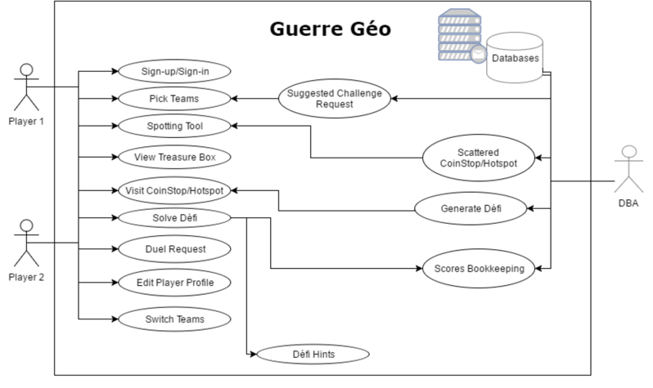
Notes:
Breifly mention the 2 players involved and DBA

Slide 5


Choose Teams
OR
Notes:
One of the use case is that player is able to pick a team they want to play for. To fulfill this requirement, we will need provide an option to choose between the two teams and this selection would be recorded into the database.
Once they have selected the team they will not be able to change the team unless they earn a gem by solving a defi at hotstpot

Slide 6
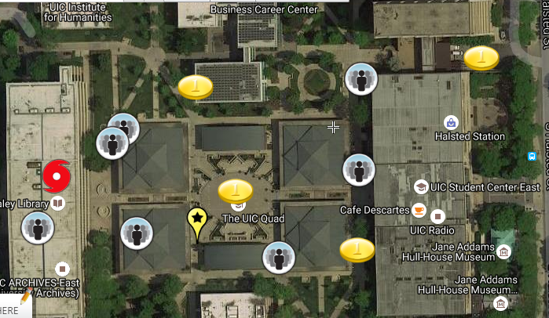
Spotting Tool
Opposite Team Player
[Request Duel]
Coinstop
[Solve Defi &
Earns points]
HotSpot
[Collect Gems]
Player’s current location

Slide 7

Duel Request
Entry Condition
Player in same location
Players from opposite teams
Events
Find opponent team
Request duel
Notes:
Entry Condition:
The opponent player should be in the same location.
The opponent should be from the opposite team.
Exit Condition:
The opponent player accepts the duel
Player finds other players from the opposite team in same location.
Finds an opponent and clicks on the opponent’s icon.
Views the opponent’s profile.
Requests a duel that both the players can play.

Slide 8
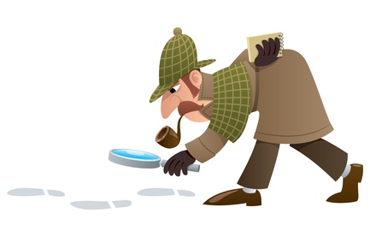
Generate Defi
DBA read location
Check location and player
DBA creates defi
Notes:
Entry condition:
User’s location is on and linked to the server
The Coinstop/Hotspot are scattered in the city.
A predefined library, which will store information of various locations,
will be created.
Based on the locations and the type of the player the défi gets generated.
Player screen will display the generated défi.

Slide 9
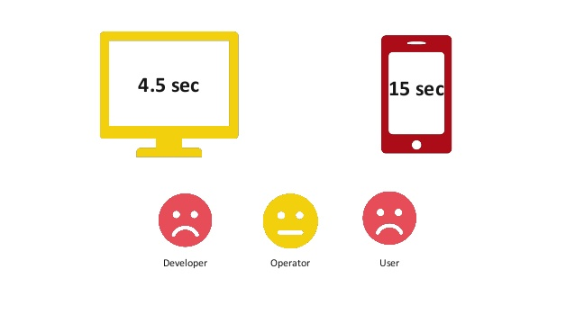
Performance
Defi generated
Update location
Spotting tool in 5 seconds
Accurate defi
Notes:
To give best user experience, the game should perform quickly. System should generate defi and update player’s location in less than 2 seconds. It should load spotting tool in less than 5 seconds.
To maintain fairness, defi should be accurately generated based on the location and team of the player.

Slide 10


Dependability and Maintainability
Available 24x7, year round
No Data Loss
No Security Protocols Skipped
Not responsible for User’s actions or injuries

Slide 11

Usability and Humanity
Easy to play and use
Appealing GUI
Personalized for user’s culture & language
High school level education and above
Notes:
Usability and Humanity: Ease to play, use, understand instructions and should not be annoyed or frustrated but give challenging trivia, personalized for multiple languages, cultural terms, idioms and symbols, general audience in high school and over, no training needed for game but for developers there will be a manual
16.Usability and Humanity Requirements .........................................
17. Look and Feel Requirements ....................................................
18. Operational and Environmental Requirements
The game should have appealing GUI. It should be easily navigable and readable by the users.

Slide 12

Cultural, Legal and Political Requirements
Not offend anyone
No Political Affiliation
Comply with the law of each nation
Notes:
Cultural: not suitable for someone who has dislike for anything French, are anti-war or anti-violent in any form, do not believe in good and evil/bad and any religious or cultural section that is against some members of society not learning about the world around them
Political: No problems with Mac and Windows, Game Clues will involve politics and history of politics as trivia questions, not be biased or incline towards a specific group.

Slide 13

Features to be Tested
Spotting tool
Defi
Requesting duel
Notes:
We must test that spotting tool shows nearby user, coinspots, and hotspots.
Further we should test that defi is generated related to the location and when user solves it, the answer is checked accurately and the result is stored into the db.
We should also test that when use requests duel, the system checks that the user is from opponent teams.

Slide 14

Pass Fail Criteria
Solving defi
Duel request
Accurate location
Notes:
Solving défi - It's answer must match to the correct answer.
Duel Request - Player should only be able to request duel when another player is nearby.
Location - Défi must only be based on the player's location and player's location should be updated in the spotting tool under 3 seconds.
There should be défi available for all coinspot and hotspots.

Slide 15

Thank You

